Slide 1
Data Science:
Knowing the data.
Based on slides of Jiawei Han
Kadir Has University,
Fall 2025

Slide 2
Chapter 2: Getting to Know Your Data
Data Objects and Attribute Types
Basic Statistical Descriptions of Data
Data Visualization
Measuring Data Similarity and Dissimilarity
Summary

Slide 3
Types of Data Sets
Record
Graph and network
Ordered
Spatial, image and multimedia

Slide 4
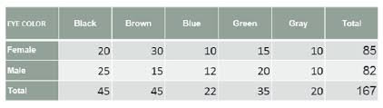
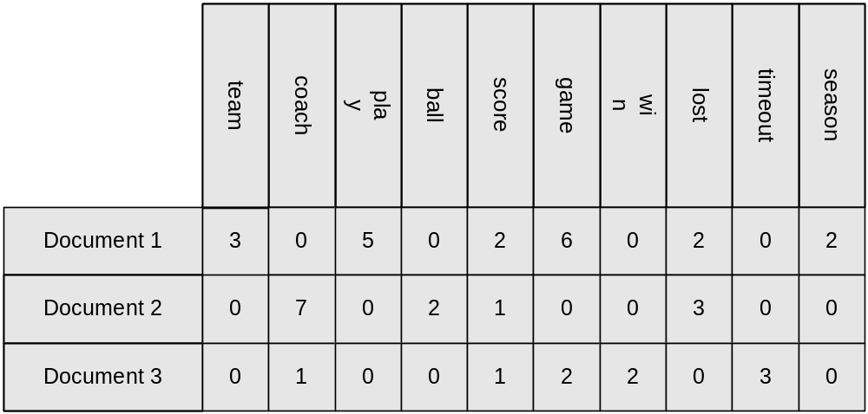

Types of Data Sets
Record
  Relational records
  Data matrix, e.g., numerical matrix, crosstabs
  Document data: text documents: term-frequency vector
  Transaction data

Slide 5
Types of Data Sets
Graph and network
  World Wide Web
  Social or information networks
  Molecular Structures
Ordered
  Video data: sequence of images
  Temporal data: time-series
  Sequential Data: transaction sequences
  Genetic sequence data
Spatial, image and multimedia:
  Spatial data: maps
  Image data
  Video data

Slide 6


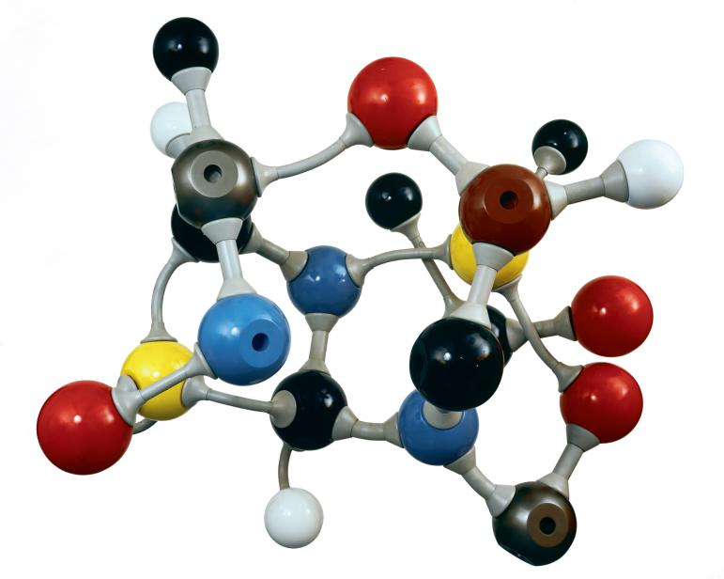
Types of Data Sets
Graph and network
  World Wide Web
  Social or information networks
  Molecular Structures

Slide 7
Types of Data Sets
Ordered
  Video data: sequence of images
  Temporal data: time-series
  Sequential Data: transaction sequences
  Genetic sequence data
Spatial, image and multimedia:
  Spatial data: maps
  Image data
  Video data

Slide 8
Data Objects
Data sets are made up of data objects.
A data object represents an entity.
Examples:
  sales database: customers, store items, sales
  medical database: patients, treatments
  university database: students, professors, courses
Also called samples , examples, instances, data points, objects, tuples.
Data objects are described by attributes.
Database rows -> data objects; columns ->attributes.

Slide 9
Attributes
Attribute (or dimensions, features, variables): a data field, representing a characteristic or feature of a data object.
  E.g., customer _ID, name, address
Types:
  Nominal
  Binary
  Ordinal
  Numeric: quantitative
    Interval-scaled
    Ratio-scaled

Slide 10
Attribute Types
Nominal: categories, states, or “names of things”
  Hair_color = {auburn, black, blond, brown, grey, red, white}
  marital status, occupation, ID numbers
  Give another example for nominal data type

Slide 11
Attribute Types
Binary
  Nominal attribute with only 2 states (0 and 1)
  Symmetric binary: both outcomes equally important
    e.g., gender
  Asymmetric binary: outcomes not equally important.
    e.g., medical test (positive vs. negative)
    Convention: assign 1 to most important outcome (e.g., HIV positive)
  Give other examples for both types of binary data

Slide 12
Attribute Types
Ordinal
  Values have a meaningful order (ranking) but magnitude between successive values is not known.
  Size = {small, medium, large}, grades, army rankings

Slide 13
Numeric Attribute Types
Quantity (integer or real-valued)
Interval
    Measured on a scale of equal-sized units
    Values have order
      E.g., temperature in C˚or F˚, calendar dates
    No true zero-point
    E.g., date: the length from 10 Sep. to 20 Sep. is 10 days
Ratio
    Inherent zero-point
    We can speak of values as being an order of magnitude larger than the unit of measurement (10 K˚ is twice as high as 5 K˚).
      e.g., temperature in Kelvin, length, counts, monetary quantities
      Money: 10 TLs is twice 5 TLs

Slide 14
Discrete vs. Continuous Attributes
Discrete Attribute
  Has only a finite or countably infinite set of values
    E.g., zip codes, profession, or the set of words in a collection of documents
  Sometimes, represented as integer variables
  Note: Binary attributes are a special case of discrete attributes
Continuous Attribute
  Has real numbers as attribute values
    E.g., temperature, height, or weight
  Practically, real values can only be measured and represented using a finite number of digits
  Continuous attributes are typically represented as floating-point variables

Slide 15
Chapter 2: Getting to Know Your Data
Data Objects and Attribute Types
Basic Statistical Descriptions of Data
Data Visualization
Measuring Data Similarity and Dissimilarity
Summary

Slide 16
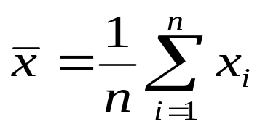


Measuring the Central Tendency
Mean (algebraic measure) (sample vs. population):
  Note: n is sample size and N is population size.
  Weighted arithmetic mean:
  Trimmed mean: chopping extreme values
  Harmonic mean (Homework!), when do we use a harmonic mean? How to take harmonic mean of k items?

Slide 17
Measuring the Central Tendency
Mean (algebraic measure) (sample vs. population):
  Note: n is sample size and N is population size.
  Weighted arithmetic mean:
  Trimmed mean: chopping extreme values
  Harmonic mean (Homework!), when do we use a harmonic mean? How to take harmonic mean of k items?

Slide 18


Measuring the Dispersion of Data
Variance and standard deviation (sample: s, population: σ)
  Variance: (algebraic, scalable computation)
  Standard deviation s (or σ) is the square root of variance s² ⁽or σ²⁾
  Example: 30 36 47 50 52 52 56 60 63 70 70 110
  Average = 58
  Var = 379.16 ,
  std =19.47

Slide 19
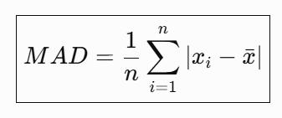
Measuring the Dispersion of Data
  Mean Absolute Deviation (MAD): the average distance of data points from the mean of a dataset. Unlike variance, it uses absolute values, making it easy to understand.
Small MAD → Data points are close to the mean (low variability).
Large MAD → Data points are more spread out (high variability).

Slide 20
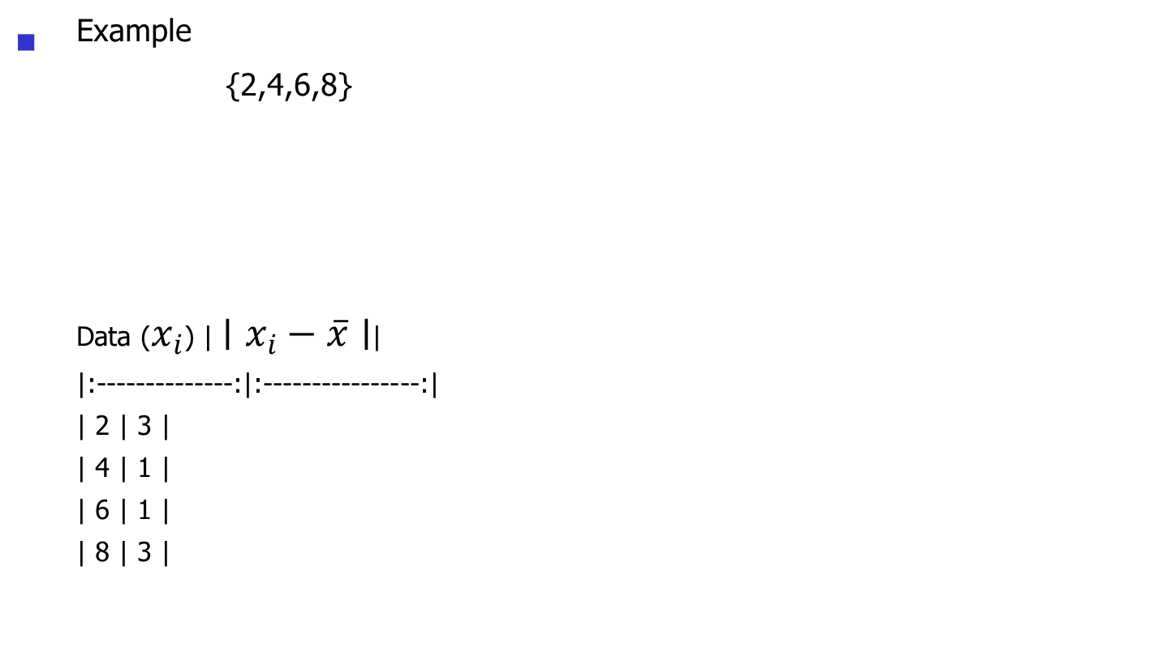
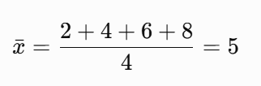
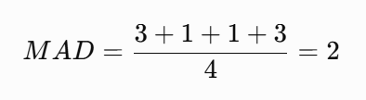
Measuring the Dispersion of Data

Slide 21
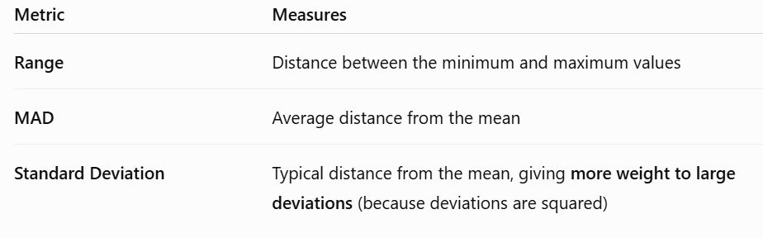
comparison

Slide 22
Measuring the Central Tendency
Median:
  Middle value if odd number of values, or average of the middle two values, otherwise
  Ex: what is the median in: 1 4 6 6 9 11 19 22 28 30

Slide 23
Measuring the Central Tendency
Mode
  Value that occurs most frequently in the data
  Unimodal, bimodal, trimodal
  Empirical formula:

Slide 24
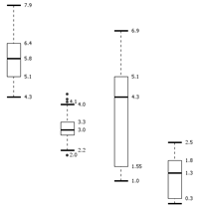
Measuring the Dispersion of Data
Quartiles, outliers and boxplots
  Quartiles: Q₁ (25th percentile), Q₃ (75th percentile)
  Inter-quartile range: IQR = Q₃ – Q₁
  Five number summary: min, Q₁, median, Q₃, max
  Boxplot: ends of the box are the quartiles; median is marked; add whiskers, and plot outliers individually
  Outlier: usually, a value higher/lower than 1.5 x IQR (lower than Q1 -1.5 IQR or greater than Q3 + 1.5 IQR)
  Ex.:
  30, 36, 47, 50, 52, 52, 56, 60, 63, 70, 70, 110
  => IQR= 66.5-48.5 =18

Slide 25
Data Distribution
Distribution | Typical Example
Normal (Gaussian) | Heights, exam scores, measurement errors
Uniform | Dice rolls, random number generation
Bernoulli | Spam vs. not spam, pass/fail, yes/no
Binomial | Number of successes in repeated trials (e.g., coin flips)
Poisson | Number of emails, customers, or accidents per hour
Exponential | Waiting time until the next event (e.g., next customer arrival)
Log-Normal | Salaries, house prices, stock prices
Student's t | Small-sample statistical inference

Slide 26
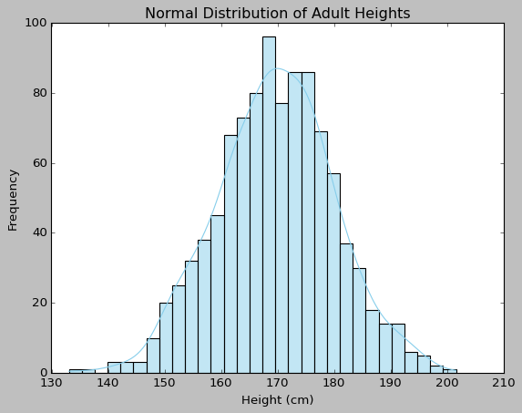
Normal Distribution
Normal or Gaussian distribution is a common way to describe how data points are spread out around a mean (average) value. It forms the classic "bell curve" shape.
Many natural phenomena follow this pattern:
heights of people,
Blood pressure
Birth weights
Exam scores (large classes)

Slide 27
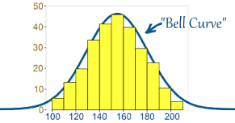
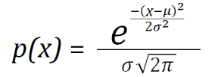
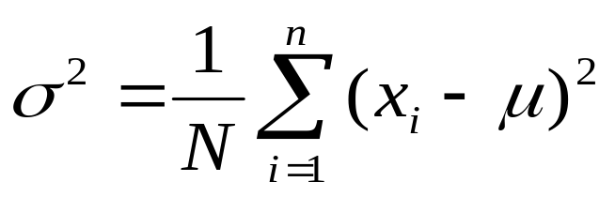
Normal Distribution Curve

Slide 28
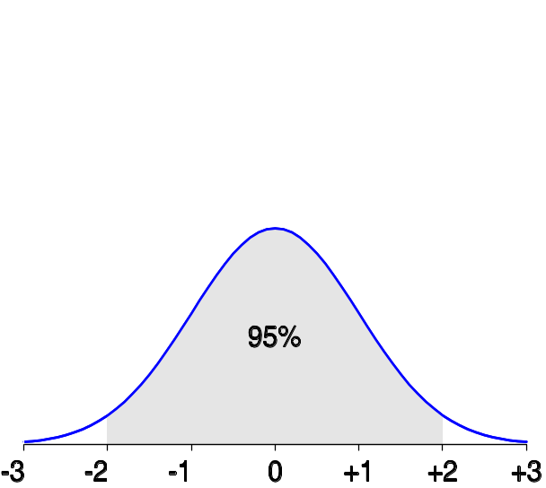
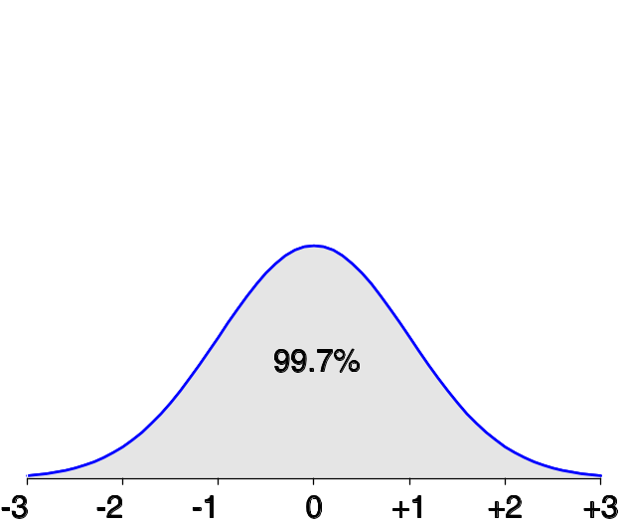
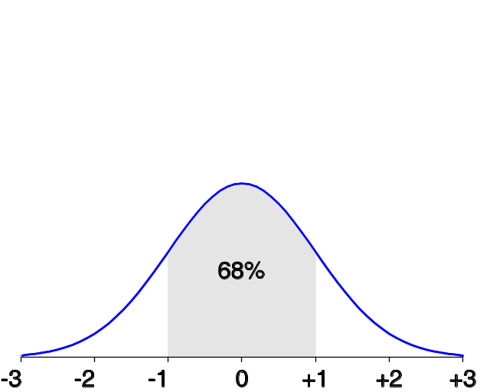
Properties of Normal Distribution Curve
The normal (distribution) curve
  From μ–σ to μ+σ: contains about 68% of the measurements (μ: mean, σ: standard deviation)
  From μ–2σ to μ+2σ: contains about 95% of it
  From μ–3σ to μ+3σ: contains about 99.7% of it

Slide 29
Normal Distribution: Human Heights
Mean (μ) = 175 cm
Standard deviation (σ) = 7 cm
Question:
What percentage of men are between 168 cm and 182 cm?
Notice that
168 = μ − 1σ
182 = μ + 1σ
Using the empirical rule:
About 68% of people fall within one standard deviation.

Slide 30
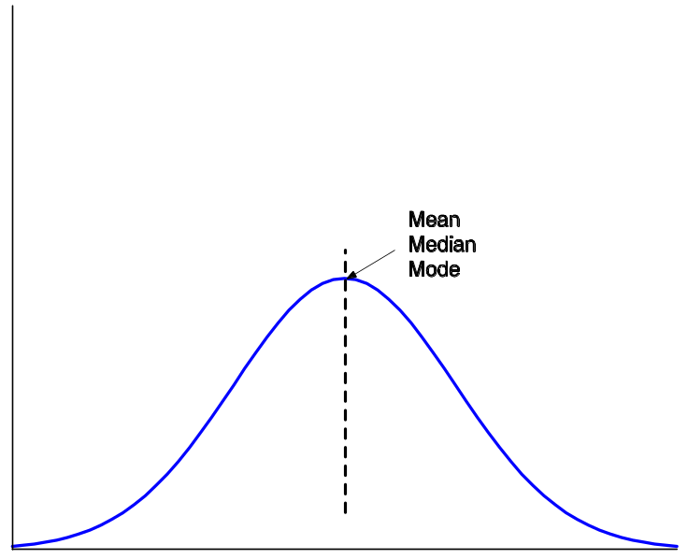


Symmetric vs. Skewed Data
Median, mean and mode of symmetric, positively and negatively skewed data
symmetric
positively skewed
negatively skewed
Data Mining: Concepts and Techniques

Slide 31
Chapter 2: Getting to Know Your Data
Data Objects and Attribute Types
Basic Statistical Descriptions of Data
Data Visualization
Measuring Data Similarity and Dissimilarity
Summary

Slide 32
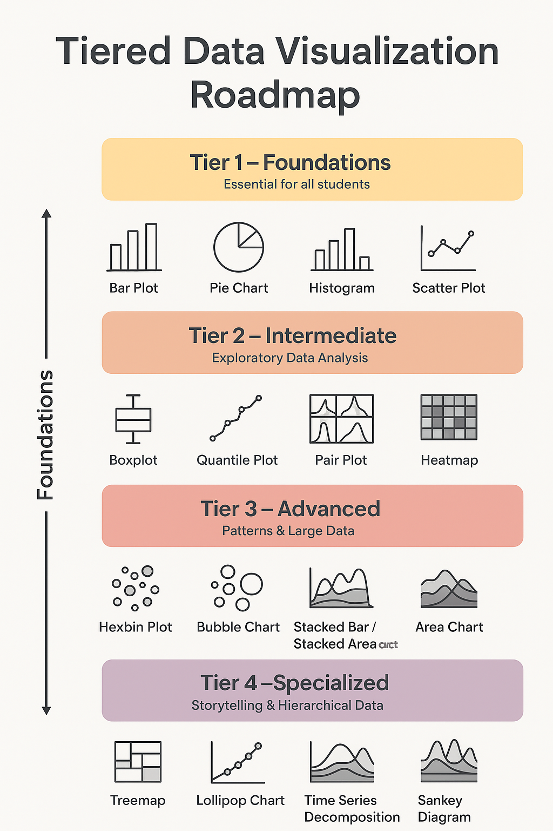

Slide 33
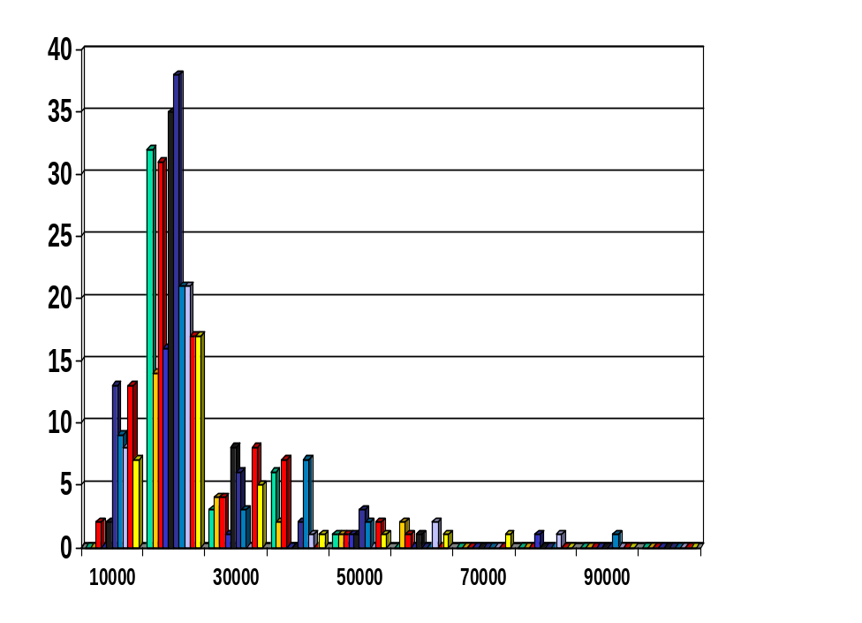
Histogram Analysis
Displays the frequency (count) of values within continuous intervals called bins.
The x-axis represents value ranges (bins), while the y-axis shows the number of observations.
Bars are adjacent (touching) because the data are continuous.
Unlike a bar chart, a histogram shows numerical intervals, not separate categories.

Slide 34
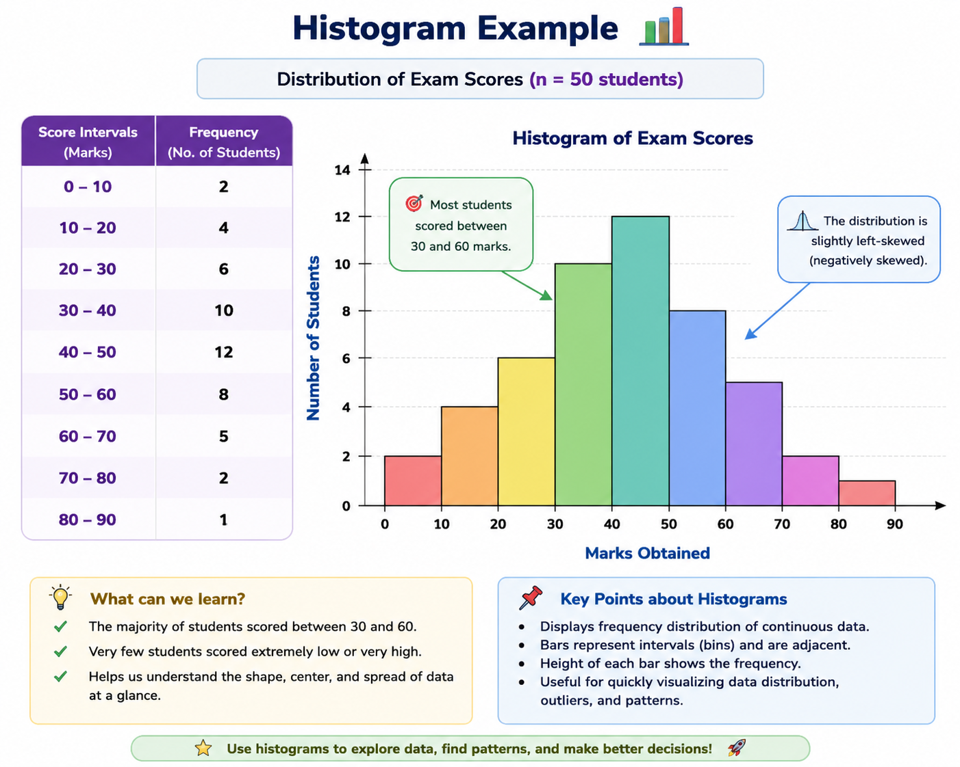

Slide 35
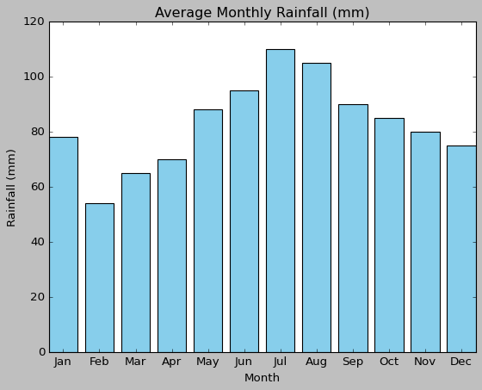
Bar Chart
A graphical representation of data using rectangular bars, where the length or height of each bar represents the value of the corresponding category. Bars can be displayed vertically or horizontally to compare different categories or groups.
Application:
compare quantities across different categories, such as sales numbers by product, or population by country

Slide 36
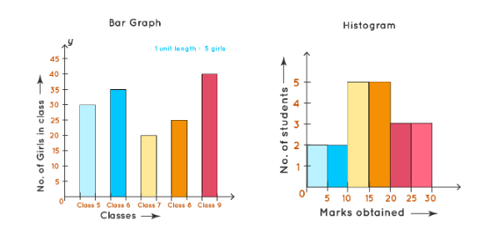
Histograms VS Bar chart
Bar Graph | Histogram
Equal space between every two consecutive bars. | No space between two consecutive bars. They should be attached to each other.
X-axis can represent anything. | X-axis should represent only continuous data that is in terms of numbers.

Slide 37
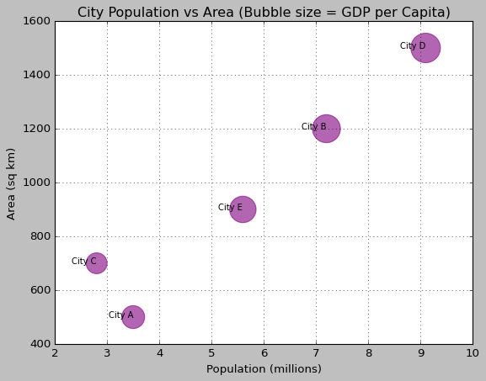
Bubble Chart
A bubble chart is a type of scatter plot where each point is represented by a bubble.
Application:
Visualizing relationships between three variables simultaneously.
Any situation where you want to compare data points with an additional size dimension.
Bubble size: an average measure of economic output

Slide 38
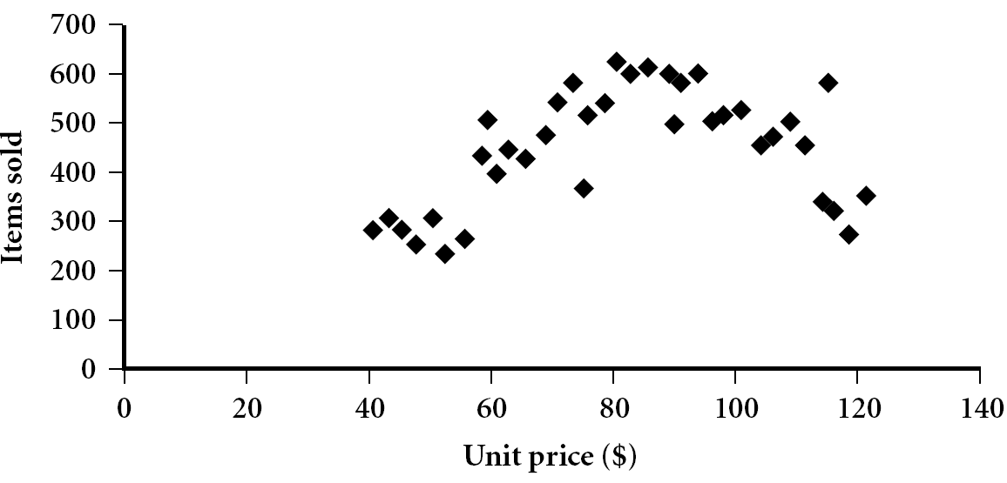
Scatter plot
Provides a first look at bivariate data to see clusters of points, outliers, etc
Each pair of values is treated as a pair of coordinates and plotted as points in the plane

Slide 39


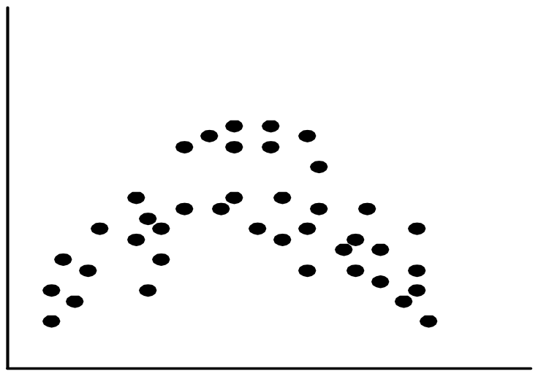
Positively and Negatively Correlated Data
The left half fragment is positively correlated
The right half is negative correlated

Slide 40


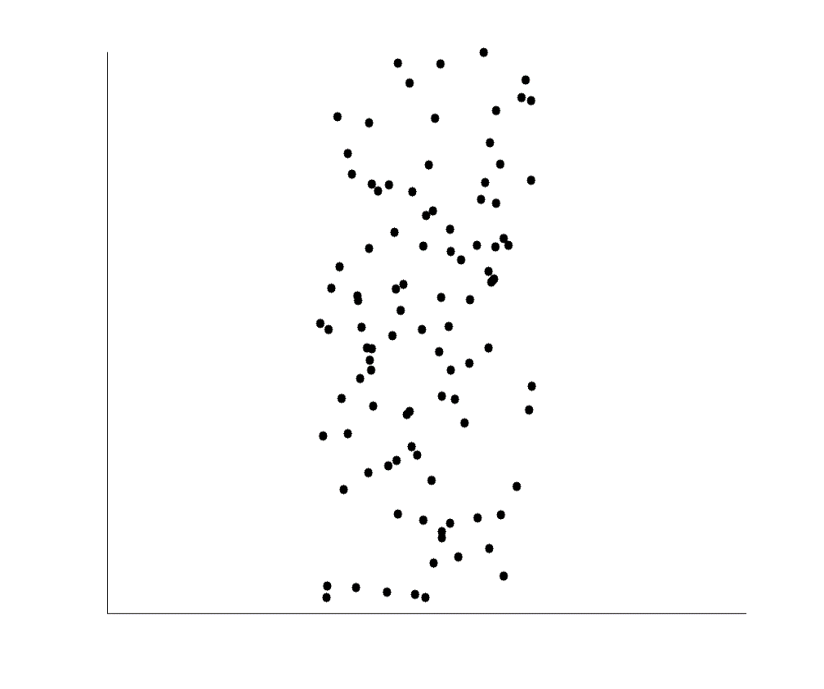
Uncorrelated Data

Slide 41
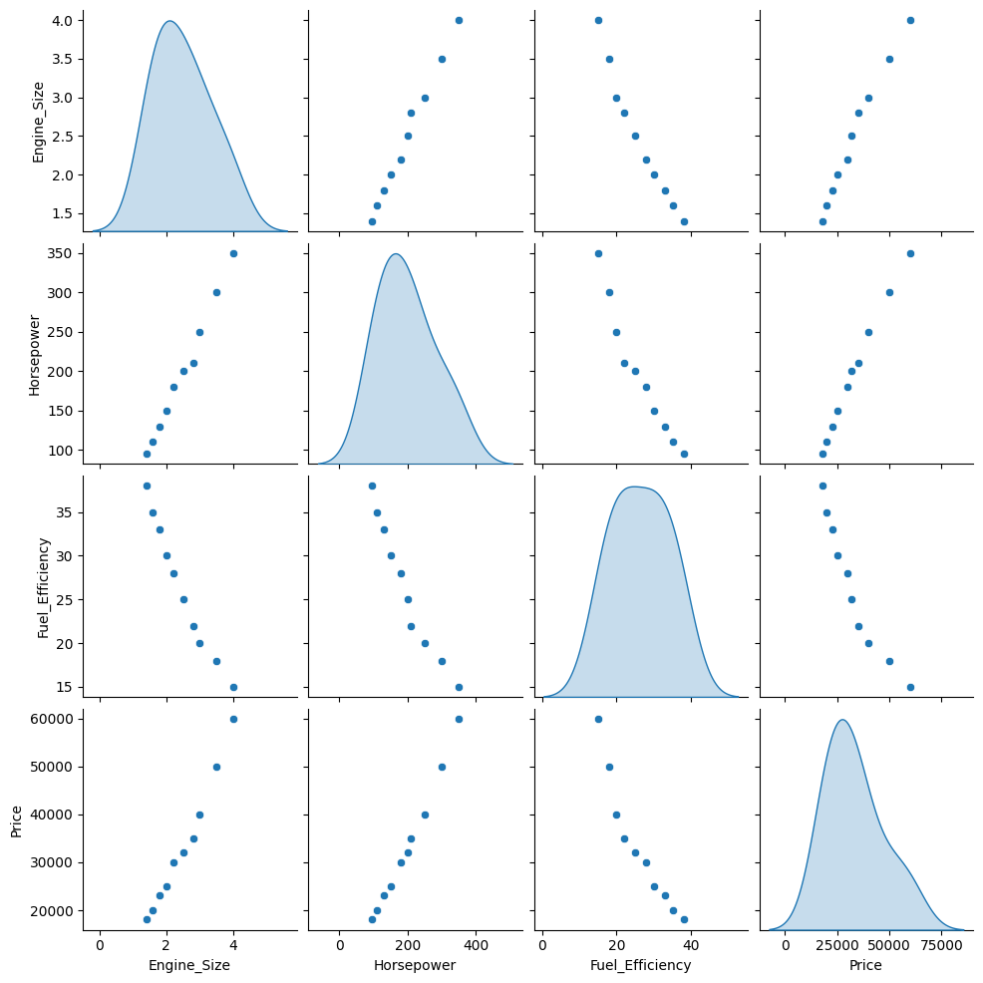
Pairplot
pair plot shows scatter plots for every pair of numerical variables in a dataset.
A pairplot is used to visualize relationships between multiple variables in a dataset at once. It creates scatterplots for every pair of numerical variables and histograms (or density plots) for individual variables on the diagonal

Slide 42
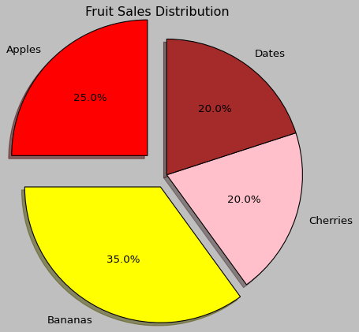
Pie plot
A pie chart is a circular chart divided into slices, where each slice represents a proportion of a whole.
When to Use:
To show part-to-whole relationships.
When there are few categories (ideally 3–6).
When differences between values are large enough to see clearly.

Slide 43
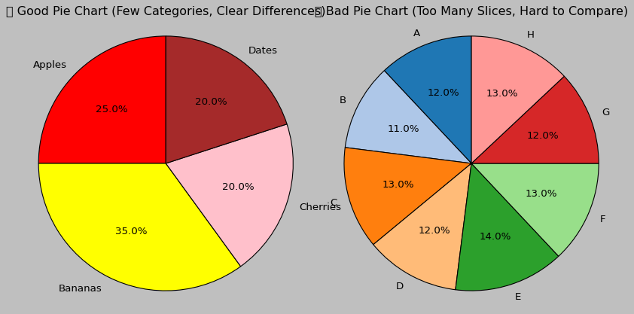
Pie plot
Good vs Bad Pie chart

Slide 44
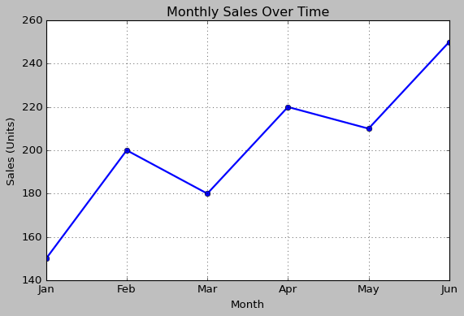
Line Chart
A graph that displays data points connected by straight lines, typically used to show how values change over time or in sequence.

Slide 45
Line Chart
Applications
Tracking trends over time (e.g., monthly sales, website traffic).
Comparing changes across multiple series.
Showing patterns such as growth, decline, or seasonality.
Monitoring continuous data like temperature, stock prices, or sensor readings.

Slide 46
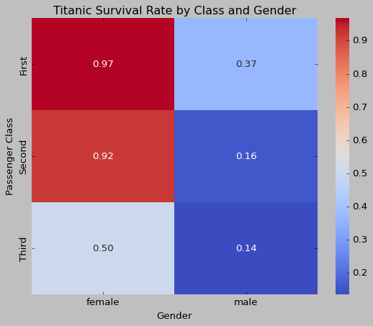
Heatmap
A heatmap is a data visualization technique that uses colors to represent the magnitude of values in a matrix or table, where darker or more intense colors indicate higher values and lighter colors indicate lower values.

Slide 47
Heatmap
Application:
Heatmaps are commonly used to visualize correlations between variables, show patterns in large data sets, or display intensity of activity such as website click data or gene expression levels in biology.

Slide 48
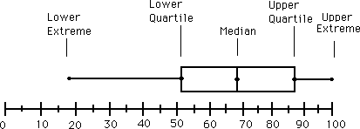
Boxplot Analysis
Five-number summary of a distribution
  Minimum, Q1, Median, Q3, Maximum
Boxplot
  Data are represented with a box
  The ends of the box are at the first and third quartiles, i.e., the height of the box is IQR
  The median is marked by a line within the box
  Whiskers: two lines outside the box extended to Minimum and Maximum
  Outliers: points beyond a specified outlier threshold, plotted individually

Slide 49
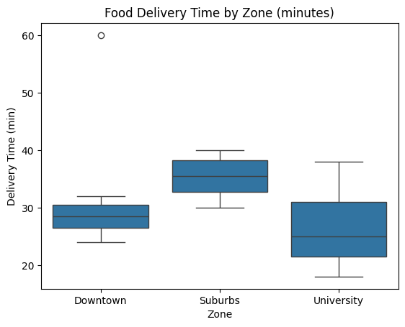
Visualization of Data Dispersion: 3-D Boxplots
Data Mining: Concepts and Techniques

Slide 50
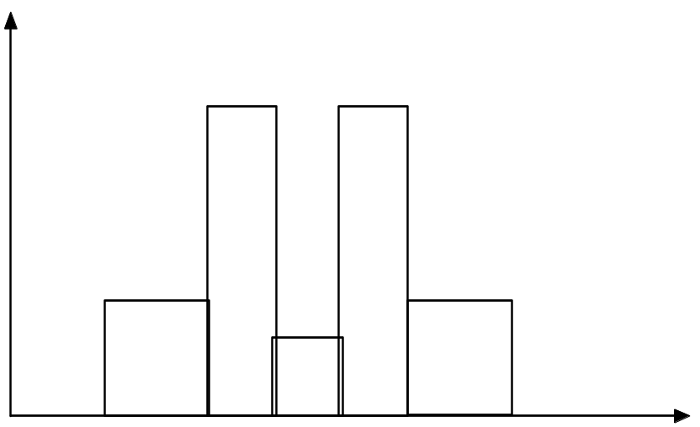
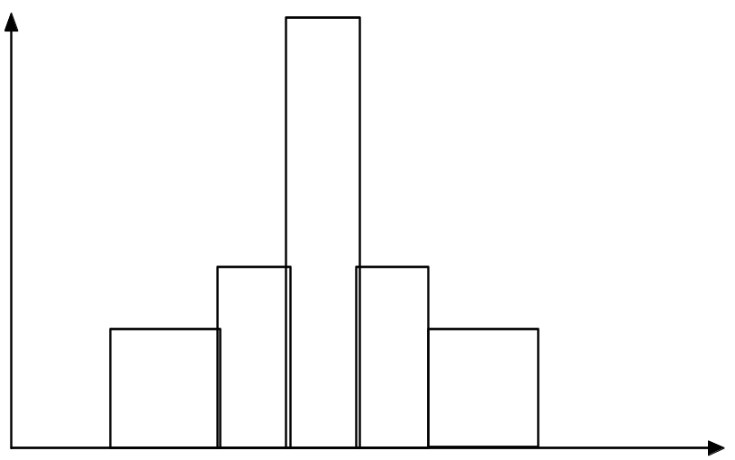
Histograms Often Tell More than Boxplots
The two histograms shown in the left may have the same boxplot representation
  The same values for: min, Q1, median, Q3, max
But they have rather different data distributions

Slide 51
Area chart
Area chart is a line chart with the area below the line filled with color to emphasize the magnitude of values over time.
Features:
It is commonly used in business dashboards, finance, website analytics, and sales reports.
Shows trends over time.
Filled area emphasizes the magnitude of values.
Ideal for cumulative values and overall growth.
Best used when the x-axis represents time.

Slide 52
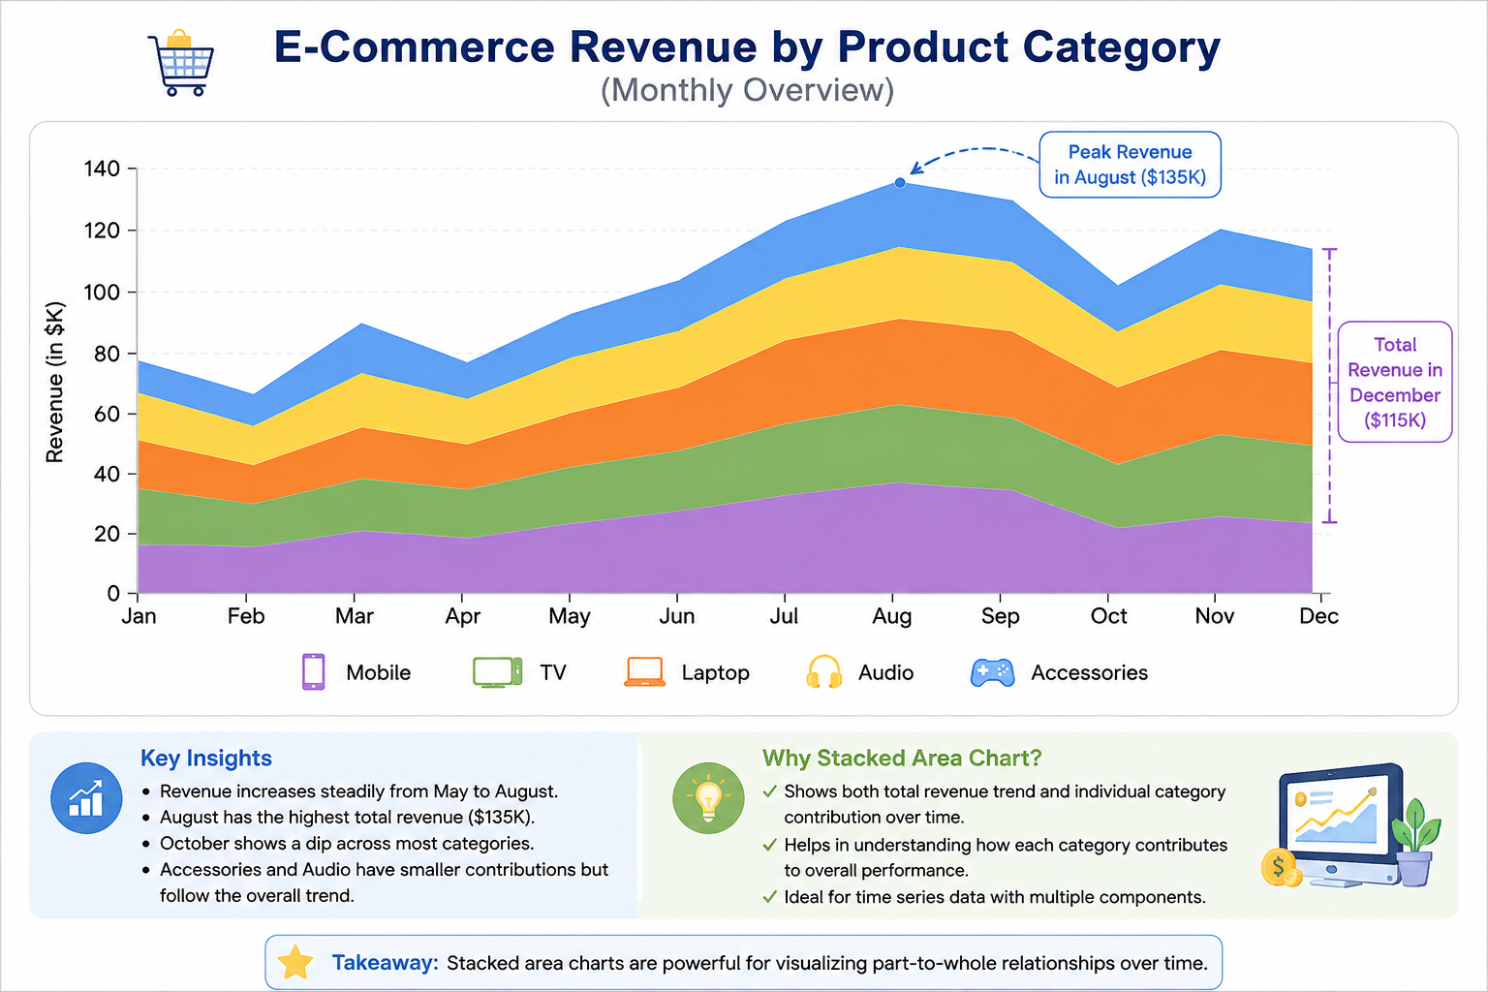
Area chart example

Slide 53
Word cloud
A word cloud is a visualization that displays the most frequent words in a text dataset. The more frequently a word appears, the larger it is shown.
Features:
Visualizes word frequency using font size.
Frequently occurring words appear larger than less frequent ones.
Quickly identifies the main topics in a collection of text.
Often created after removing stop words (e.g., the, is, and).
Can use different colors, fonts, and shapes for better presentation.

Slide 54

Word cloud example
This is a word cload created on a text related to Kadir Has University

Slide 55
Chapter 2: Getting to Know Your Data
Data Objects and Attribute Types
Basic Statistical Descriptions of Data
Data Visualization
Measuring Data Similarity and Dissimilarity
Summary

Slide 56
Similarity and Dissimilarity
Similarity
  Numerical measure of how alike two data objects are
  Value is higher when objects are more alike
  Often falls in the range [0,1]
Dissimilarity (e.g., distance)
  Numerical measure of how different two data objects are
  Lower when objects are more alike
  Minimum dissimilarity is often 0
  Upper limit varies
Proximity refers to a similarity or dissimilarity

Slide 57


Data Matrix and Dissimilarity Matrix
Data matrix
  n data points with p dimensions
  Two modes
Dissimilarity matrix
  n data points, but registers only the distance
  A triangular matrix
  Single mode

Slide 58

Proximity Measure for Nominal Attributes
Can take 2 or more states, e.g., red, yellow, blue, green (generalization of a binary attribute)
Method 1: Simple matching
  m: # of matches, p: total # of variables
Method 2: Use a large number of binary attributes
  creating a new binary attribute for each of the M nominal states

Slide 59
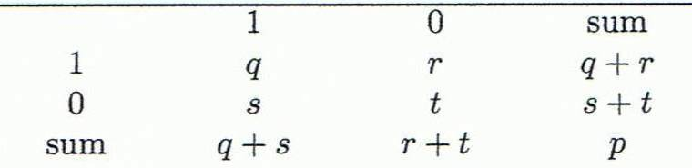
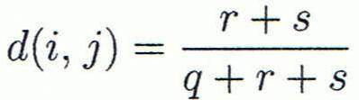
Proximity Measure for Binary Attributes
Object j
A contingency table for binary data
Q,r,s, and t are the number of binary attributes between two objects with a different combination of 1’s and 0’s.
Distance measure for binary variables:
Object i

Slide 60


Dissimilarity between Binary Variables
Example
  Gender is a symmetric attribute
  The remaining attributes are asymmetric binary
  Let the values Y and P be 1, and the value N 0

Slide 61
Distance on Numeric Data: Minkowski Distance
Minkowski distance: A popular distance measure
  where i = (x_{i1}, x_{i2}, …, x_{ip}) and j = (x_{j1}, x_{j2}, …, x_{jp}) are two p-dimensional data objects, and h is the order (the distance so defined is also called L-h norm)
Properties
  d(i, j) > 0 if i ≠ j, and d(i, i) = 0 (Positive definiteness)
  d(i, j) = d(j, i) (Symmetry)
  d(i, j) ≤ d(i, k) + d(k, j) (Triangle Inequality)
A distance that satisfies these properties is a metric

Slide 62


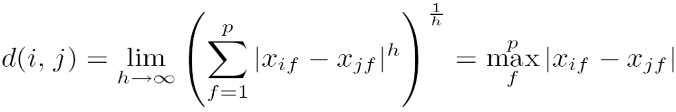
Special Cases of Minkowski Distance
h = 1: Manhattan (city block, L₁ norm) distance
  E.g., the Hamming distance: the number of bits that are different between two binary vectors
h = 2: (L₂ norm) Euclidean distance
h → ∞. “supremum” (L_{max} norm, L∞ norm) distance.
  This is the maximum difference between any component (attribute) of the vectors

Slide 63
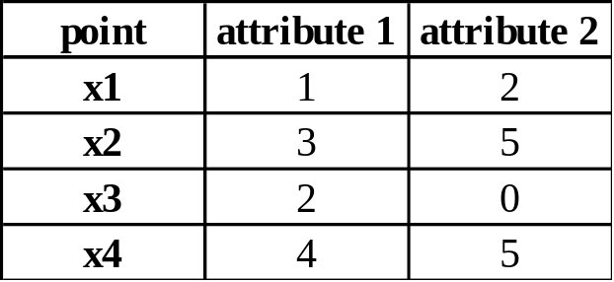
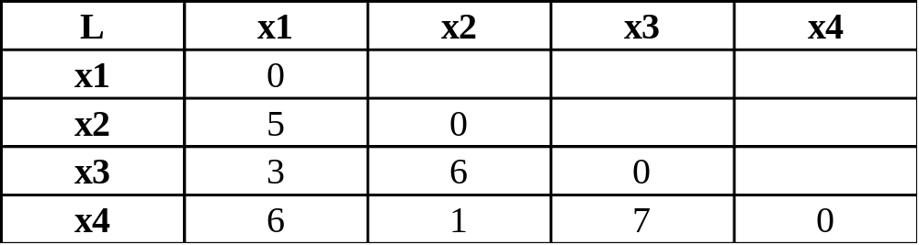
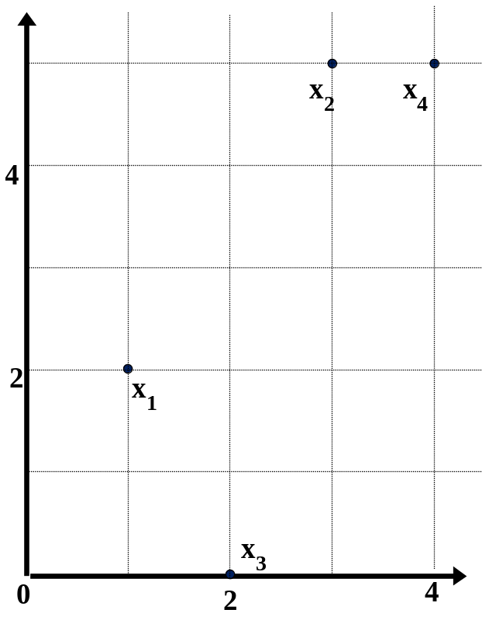
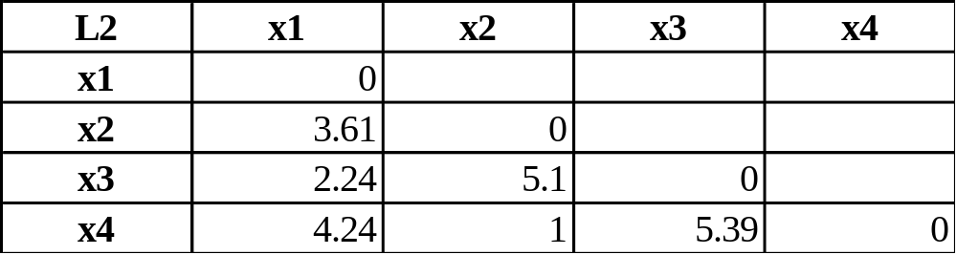
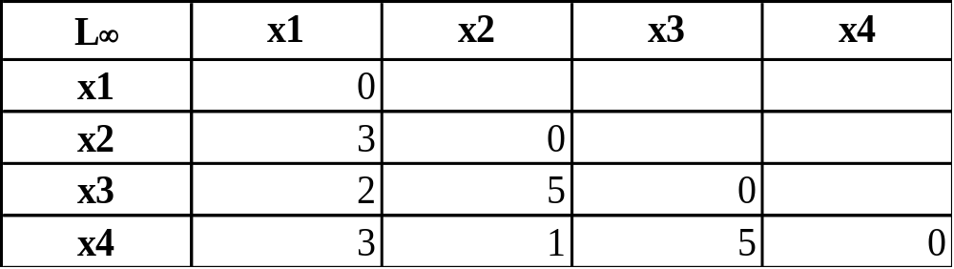
Example: Minkowski Distance
Dissimilarity Matrices
Manhattan (L₁)
Euclidean (L₂)
Supremum

Slide 64


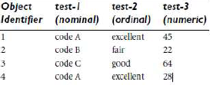
Ordinal Variables
An ordinal variable can be discrete or continuous
Order is important, e.g., rank
Can be treated like interval-scaled
  replace x_{if} by their rank
  map the range of each variable onto [0, 1] by replacing i-th object in the f-th variable by
  compute the dissimilarity using methods for interval-scaled variables, e.g., fair = 0, good = 0.5, excellent = 1 in the following dataset:

Slide 65

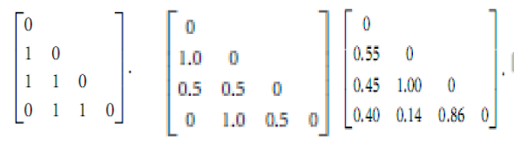
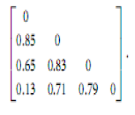
An Exp. of object similarity with Attributes of
Mixed Type
Numeric distance can be
normalized by the max value
In numeric case, distances are normalized
By the maximum distance btw any pair of objects

Slide 66
Another Exp. of object similarity with Attributes of
Mixed Type
Assume there two apartments and we want to calculate their similarity with an ideal apartment.
Attribute Type | Attribute Name | Description | Example Values
Numeric | Rent Price (€) | Monthly rent | 900, 1100
Binary | Has Balcony? | Yes (1) / No (0) | 1, 0
Nominal | Neighborhood | Categorical name | "Central", "Suburban", "Coastal"
Ordinal | Furnishing Level | Rank from 1=Unfurnished, 2=Partially, 3=Fully Furnished | 2, 3

Slide 67
Another Exp. of object similarity with Attributes of
Mixed Type
We want to compute overall similarity between:
Apartment A: 900 €, Balcony=Yes, Neighborhood=Central, Furnishing=Fully
Apartment B: 1100 €, Balcony=No, Neighborhood=Suburban, Furnishing=Partially
and the Ideal apartment:
Ideal: 1000 €, Balcony=Yes, Neighborhood=Central, Furnishing=Fully

Slide 68
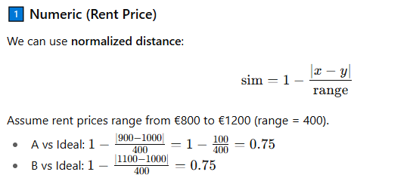
Another Exp. of object similarity with Attributes of
Mixed Type
Numeric distance can be
normalized by the max value

Slide 69
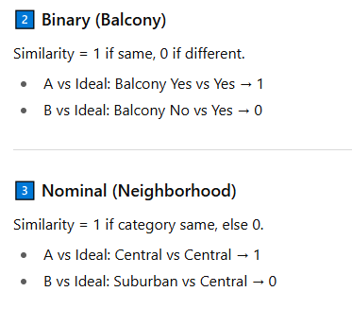
Another Exp. of object similarity with Attributes of
Mixed Type

Slide 70

Another Exp. of object similarity with Attributes of
Mixed Type

Slide 71

Another Exp. of object similarity with Attributes of
Mixed Type

Slide 72

Cosine Similarity
A document can be represented by thousands of attributes, each recording the frequency of a particular word (such as keywords) or phrase in the document.
Other vector objects: gene features in micro-arrays, …
Applications: information retrieval, biologic taxonomy, gene feature mapping, ...
Cosine measure: If d₁ and d₂ are two vectors (e.g., term-frequency vectors), then
cos(d₁, d₂) = (d₁ • d₂) /||d₁|| ||d₂|| ,
  where • indicates vector dot product, ||d||: the length of vector d

Slide 73
Example: Cosine Similarity
cos(d₁, d₂) = (d₁ • d₂) /||d₁|| ||d₂|| ,
  where • indicates vector dot product, ||d|: the length of vector d
Ex: Find the similarity between documents 1 and 2.
  d₁ = (5, 0, 3, 0, 2, 0, 0, 2, 0, 0)
  d₂ = (3, 0, 2, 0, 1, 1, 0, 1, 0, 1)
  d₁•d₂ = 5*3+0*0+3*2+0*0+2*1+0*1+0*1+2*1+0*0+0*1 = 25
  ||d₁||= (5*5+0*0+3*3+0*0+2*2+0*0+0*0+2*2+0*0+0*0)^{0.5}=(42)^{0.5} = 6.481
  ||d₂||= (3*3+0*0+2*2+0*0+1*1+1*1+0*0+1*1+0*0+1*1)^{0.5}=(17)^{0.5} = 4.12
  cos(d₁, d₂ ) = 0.94

Slide 74
Chapter 2: Getting to Know Your Data
Data Objects and Attribute Types
Basic Statistical Descriptions of Data
Data Visualization
Measuring Data Similarity and Dissimilarity
Summary

Slide 75
Summary
Data attribute types: nominal, binary, ordinal, interval-scaled, ratio-scaled
Many types of data sets, e.g., numerical, text, graph, Web, image.
Gain insight into the data by:
  Basic statistical data description: central tendency, dispersion, graphical displays
  Data visualization: map data onto graphical primitives
  Measure data similarity
Above steps are the beginning of data preprocessing.
Many methods have been developed but still an active area of research.

